Slide 1


MARKETPLACE LENDING CASE-STUDY
Performance, Cohort Analysis, and Credit Insights
Prepared by: Norberto Rancharan

Slide 2

Objectives
1 | Clean and validate originations dataset
2 | Handling problem data and reconstruct reliable datasets
3 | Build portfolio characteristics and risk stratifications
4 | Construct monthly and cumulative performance curves
5 | Project curves to 60 months
6 | Segment risk using cohort analysis
7 | Address Covid-19 vintage treatment

Slide 3
01-02 | DATA CLEANING AND PROBLEM DATA HANDLING

Slide 4
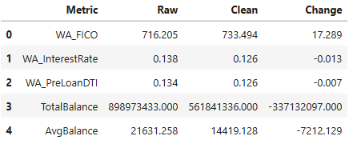
Data Cleaning Summary
Data Quality Improvements:
Initial dataset:~ 41,559 loans
Removed corrupted loans (Invalid FICO, DTI, Income, UPB)
Weighted Average (WA) FICO:
2,561 observations (6.16%) exhibited out-of-range FICO scores consisting of 0 (2433 count or 95%) and 7722 (128 count or 5%)
Increased after cleaning
WA DTI improved:
Reasonable range of 0% to 60%, anything above was beyond reasonable standards and removed
Verified Annual Income Range:
Validated to fall within $10K-$500K, anything outside was removed due to unrecoverable data corruption
WA interest rate decreased
Final dataset: ~38,965 loans

Slide 5
03 | PORTFOLIO CHARACTERISTICS

Slide 6
Portfolio Characteristics Summary
Key Metrics:
WA FICO stable across early vintages
Risk-based pricing: A -> F shows rate increases
Term Mix: Higher-risk borrowers concentrated in 36m loans
Geographic Diversification: CA, TX, MI, FL, NY largest states
Concentration risk is low: Top-100 Loans < 1% of balance
Post-loan DTI consistent across homeownership groups

Slide 7
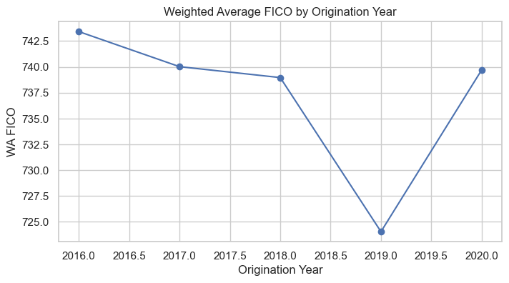
WA FICO by Origination Year
WA FICO is stable across early vintages, dips in 2019, and partially recovers in 2020, possibly due to a shift toward slightly riskier borrowers or temporary loosening of underwriting. 2020 is a COVID‑affected vintage, but credit quality (FICO) improved possibly due to defensive underwriting.
Notes:
(Critical indicator of the seller’s historical credit appetite)
2016-2018, The weighted average FICO consistently hovered right around the 740 mark.
Looks underwriting conservative, the entire portfolio focused on prime-tier credit quality.
2019. 15-point drop in the weighted average FICO, down to 724.
Strategic credit expansion, the funnel to capture more near-prime volume widened, specifically targeting the mid-tier risk grades (B,C,D as we will see later) where yield could be optimized and capture market share.
2020. The moment the macroeconomic environment shifted due to the pandemic,
(Flight to quality) The weighted average FICO surged back up to 739.7, erasing 2019 expansion. By aggressively tightening credit and shutting down riskier borrower tiers, it looks like they tried to get protection from severe default risks of the early pandemic era.

Slide 8
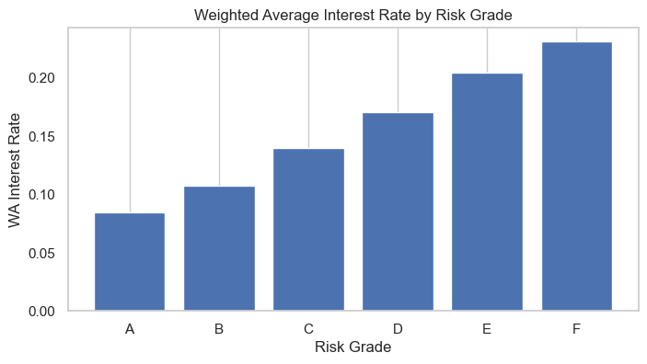
WA Interest Rate by Risk Grade
It tells you:
Higher-risk borrowers are correctly priced
Lower-risk borrowers are not overcharged
Pricing is predictable and rational
Risk‑based pricing is working exactly as expected: interest rates increase monotonically from Grade A → F, confirming strong pricing discipline.
Notes:
Grade A borrowers anchor the baseline at an attractive 8.4%. From there, the interest rate scales smoothly and logically up to 23.1% for Grade F borrowers.
The step-ups widen significantly as you go through Grades D, E, and F. By demanding an interest rate above 20% for the highest-risk tiers, they are building an aggressive yield cushion to absorb credit losses.

Slide 9
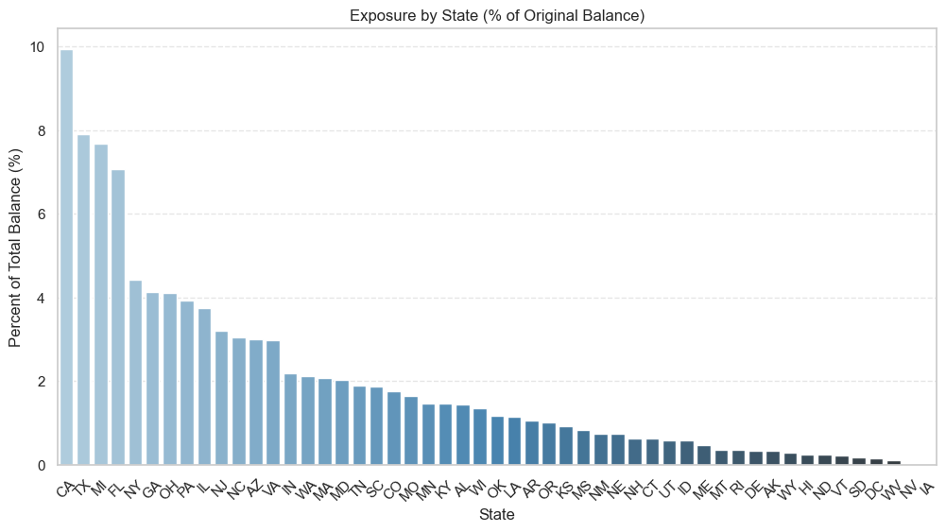
Exposure by State (% of Original Balance)
The portfolio demonstrates healthy geographic diversification with a predictable concentration in large population centers. No single state poses outsized systemic risk, but the top five states should be included in enhanced monitoring due to their combined exposure.
Notes:
(Geographic Footprint)
The highest exposure is in California, but it represents just under ten percent, coming in at 9.94%. It is followed closely by Texas at 7.91%, Michigan at 7.67%, and Florida at 7.07%.
Combined, the top five states account for roughly 37% of the total 561-million-dollar portfolio. This distribution aligns nicely with major U.S. population centers, giving us an organic market share where transaction volumes are naturally highest.
From a risk perspective, this chart confirms that there are no outsized concentration risks. Because our capital is balanced across entirely distinct state economies, the portfolio is highly insulated against local economic shocks or regional real estate downturns.

Slide 10
100 Largest Loans (% of Balance)
Top 100 Balance: 4,319,103
Total Balance: 561,841,336
% of Orig Balance from 100 Largest Loans: (0.77%)
The top 100 loans represent only 0.77% of total portfolio balance, indicating exceptionally low concentration risk and a highly granular portfolio structure that supports stable, predictable performance.

Slide 11
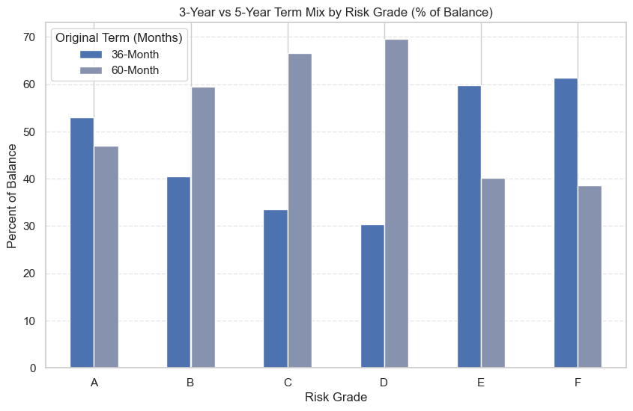
Monthly Payments by Risk Grade & Origination Year
The term mix shows disciplined underwriting. Prime borrowers (A-47%,B-59%,C-67%) lean toward longer term (5-Year) to support affordability.
Higher‑risk borrowers (E-60%,F-61%) are concentrated in shorter terms (3-Year) to limit lifetime loss exposure.
This is a positive risk‑management signal because the platform is not stretching high‑risk borrowers into long‑duration loans.
Notes:
Grade A – This mix is essentially balanced. 53% lean toward 36 month term. Borrowers have lower overall debt needs and prefer to capture lower interest rates and faster payoffs.
Grades B, C, D (Core Volume Drivers) – Progressive shift toward 60-month term. Peaks at Grade D, 70% of the balance is 60-month loans.
This serves a powerful dual purpose for the platform:
Affordability: Spreading the principal over 5 years lowers the monthly payment obligation for these mid-tier borrowers, keeping their debt-to-income ratios manageable.
Yield: It allows to maximize net interest income and investor returns on mid-tier credit bands.
Grades E, F – here is the most critical takeaway of this analysis: Look at what happens the moment we hit Grades E and F.
Instead of continuing the trend and stretching these high-risk borrowers into longer terms to chase higher yields or origination volumes, the curve completely reverses. For Grades E and F, there’s an aggressive pull back, concentrating over 60% of the balance into the shorter 36-month term.
This is a good risk management signal. Subprime and high-risk borrowers inherently face a higher velocity of default over time. By forcing a shorter 3-year window on Grades E and F, it drastically limits the 'time at risk' and accelerate principal repayment before long-term credit degradation can set in.

Slide 12
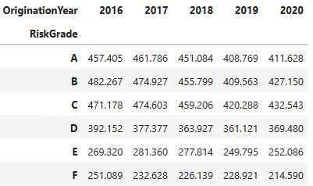
Monthly Payments by Risk Grade & Origination Year
Average monthly payments decline from 2016 to 2020 across all risk grades, reflecting a shift toward longer terms and affordability‑driven loan structures. The clear and consistent payment hierarchy across grades demonstrates disciplined risk‑based pricing and stable underwriting practices.
Notes:
If you scan the data horizontally from 2016 to 2020, you'll notice a consistent theme: average monthly payments declined across every single risk grade.
For example, look at Grade B : average payments dropped from roughly $482 down to $427.
This drop doesn’t look accidental. It directly correlates with the term mix adjustment we reviewed earlier. By strategically leveraging 60-month terms for mid-tier borrowers, their monthly financial obligations are lowered. This keeps their debt-to-income ratios manageable and builds a buffer against repayment stress, directly aiding portfolio stability over time
Secondly, here is the clear payment hierarchy, which highlights disciplined risk-based credit sizing.
Notice how prime and near-prime tiers, Grades A, B, and C, consistently sustain higher monthly payments, peaking around the $450 to $480 range. Because these borrowers present a lower probability of default, they are offered larger loan sizes, which naturally result in higher monthly payment sizes.
Conversely, look at Grades E and F. Their monthly payments are heavily suppressed, sitting down in the $210 to $280 range. Remember, we already know that these two risk tiers are heavily funneled into shorter 36-month terms. When you couple a shorter term with a much lower monthly payment, it tells us one thing clearly: the underwriting model restricts the total loan amount for high-risk borrowers. The loss exposure per loan is being capped.

Slide 13
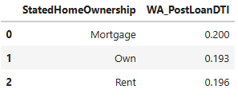
WA Post-Loan DTI by Home Own.
Weighted Average Post‑Loan DTI has a narrow spread across all home‑ownership categories, ranging from 19.3% to 20.0%, indicating strong affordability discipline and consistent underwriting standards.
Notes:
Post Loan DTI, from my understanding, loads on the new obligation to the borrower’s pre-loan DTI (borrower’s historical balance sheet) revealing their actual financial reality the moment the loan is funded. Measures the remaining household buffer after accounting for the new debt obligation.
The WA Post Loan DTI weights each borrower’s new DTI by their Original Balance. This ensures that larger loans have a proportionally larger impact on the metric.
If you look at the chart, the first thing that jumps out is the absolute value of these figures. Across all three categories, whether the borrowers have a mortgage, own their home outright, or rent, the weighted average post-loan DTI hovers tightly between 19.3% and 20.0%.
From what I understand and to put this into perspective for the broader consumer credit landscape, any DTI below 36% is traditionally viewed as highly secure
The results show the portfolio is anchored by high-surplus borrowers who retain significant financial breathing room to absorb unexpected macroeconomic shocks.

Slide 14
04 | PERFORMANCE CURVES

Slide 15
Performance Curves Summary
Monthly default rates show normal early‑month emergence
Monthly prepayment rates align with amortization and payoff behavior
No abnormal spikes or distortions in early Month On Books (MOB) for defaults

Slide 16
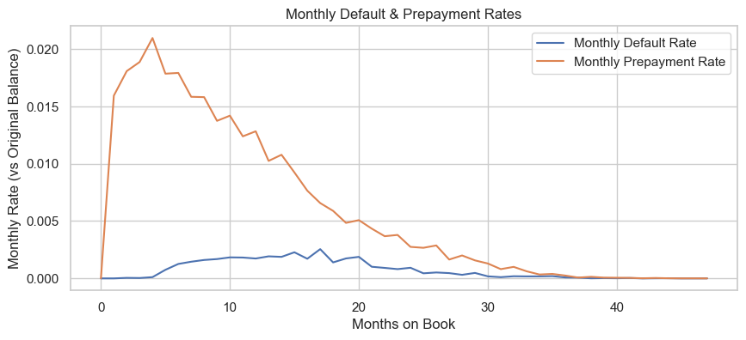
Monthly Default and Prepayment Rates
Monthly default rate measures new defaults each month as a share of the original balance.
Monthly prepayment rate measures voluntary payoffs and extra principal. How quickly balances leave the pool via good exits.
No abnormal early spikes in defaults; defaults rise modestly in early MOBs and then moderate as the pool seasons.
Monthly prepays are material in early months and then decay over time, consistent with refinance/turnover behavior.
Notes:
When evaluating a portfolio of loans, you are essentially tracking a race against time between two competing factors that reduce the outstanding balance of a loan pool:
1. Prepayments (The "Good/Neutral" Exit): This is when a borrower pays off their loan faster than scheduled. They might pay a little extra each month, make a large lump-sum payment, or refinance the entire loan to get a better interest rate.
2. Defaults (The "Bad" Exit): This is when a borrower stops making payments entirely, and the platform writes the loan off as a loss (a charge-off).
The vintage tracks loans funded at Month 0 and watches their behavior over time as they age. This timeline is measured in Months on Book (MOB).
The Math: To make sure the metrics are comparable over time, the calculation divides the dollar amount of defaults or prepayments in a given month by the original balance of the pool when it started ($543.3M).
The Scale: Because prepayments involve entire loan payoffs, they represent whole percentage points of the pool (e.g., $1.6\%$or $2.1\%$). Defaults happen on a granular, loan-by-loan basis early on, which is why they appear as tiny fractions of a percent ($0.003\%$ to $0.011\%$).
>This chart tracks the performance velocity of the loan pools from the exact month they are funded.
The visual contrast here tells a very healthy story about the front-end credit quality and portfolio liquidity.
First, look at the orange line representing Prepayments. We see an immediate, aggressive spike right out of the gate. By Month 4 on book, monthly prepayments cross 2.1% of our original pool balance. This means borrowers are rapidly paying extra principal or refinancing early. For investors, this fast velocity of returned capital acts as an organic de-risking mechanism, shielding the initial investment from long-term exposure.
Now, look at the blue line along the bottom representing Defaults. For the first four months, defaults are essentially flat, hovering near zero. In consumer lending, credit degradation takes time to cycle through delinquency buckets, so a lag is normal. However, keeping this line completely suppressed at the start confirms that our front-end fraud detection and underwriting criteria are exceptionally tight. We are not experiencing early toxic defaults.

Slide 17
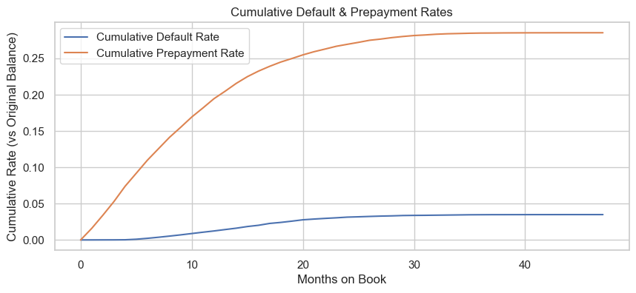
Cumulative Default and Prepayment Rates
Cumulative default measures lifetime losses to date (sum of monthly defaults).
Cumulative prepayments measure sum of monthly prepayments.
High Prepayment Rate: Cumulative prepayments climb quickly, passing 25% by Month 20 and leveling near 30% by Month 47.
Low Default Rate: Cumulative defaults stay below 5% across the asset's historical life.
Both curves are steepest between Months 5 and 25, reflecting typical "seasoning" when borrowers are most likely to prepay or default.
Notes:
While Monthly Rates show you what happens in a single isolated month, Cumulative Rates keep a running total over time. They show the total percentage of the original loan pool that has exited via default or prepayment from Day 1 up to the current month.
Think of it like a bucket filling up:
Monthly Rate: How much water was added to the bucket this month.
Cumulative Rate: The total depth of the water in the bucket right now.
The Math: If your monthly prepayment rate is roughly 1.6% in Month 1, 1.8% in Month 2, and 1.9% in Month 3, the Cumulative Prepayment Rate at Month 3 is: $1.6\%+1.8\%+1.9\%=5.3\%$
By Month 4, as your data shows, it climbs to 7.4%.
The Trajectory: This analysis tells investors exactly how fast the entire pool is dissolving. Over a 36- or 60-month lifecycle, these curves flatten out as fewer active loans remain in the pool.
This chart shows the total, running percentage of the original portfolio balance that has exited the system over time.
> Let’s focus first on the rapid rise of the orange line, which is the Cumulative Prepayment Rate. In just four months on book, 7.4% of the entire original 543-million-dollar pool has already been paid off early by borrowers. This high prepayment velocity is great news for the risk profile. It means a substantial amount of principal is being returned to investors rapidly, naturally de-risking the remaining portfolio.
In stark contrast, look at the blue line hugging the very bottom of the chart: the Cumulative Default Rate. Even after four months of portfolio seasoning, the cumulative loss is effectively flat, sitting at just 0.02%.
When you look at these two curves together, it paints a picture of a highly secure, high-velocity asset pool. Capital is returning to the seller quickly via prepayments, while the lifetime credit losses are starting at near-zero

Slide 18
05 | PROJECT CURVES TO 60 MONTHS

Slide 19
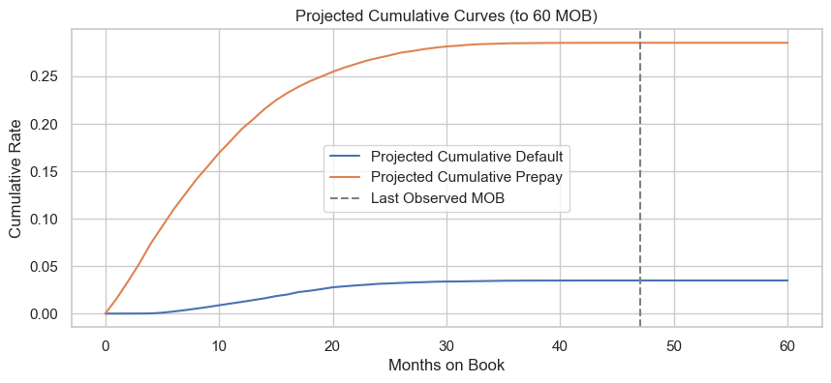
Projected Cumulative Curves (to 60 MOB)
The 60-month projection demonstrates that prepayment risk, rather than credit asset degradation (defaults), is the definitive driver of this portfolio's lifecycle and cash flow velocity.
Prepayment-driven lifecycle: Prepayments level off at 30–32% by Month 60, concentrated before Month 30, leaving cash flows stable thereafter.
Strong credit stability: The cumulative default rate stays under 5% through Month 60, with the added 13 months bringing almost no extra credit risk.
Terminal stability: After the last observed Month 47, both curves flatten, pointing to a predictable, highly "seasoned" residual pool unlikely to see sudden defaults or refinancing surges.
Notes:
A Curve Projection bridges the gap between the max mob (47, short of 13 to make 60mob). It uses the historical data available to forecast how much more money will default or prepay between Month 48 and Month 60.
How? Find the max mob, use Linear Decay (take the last monthly rate for def and prepmnts and brings them down to zero by month 60, reflecting the natural reality of a loan pool getting closer to its end date (fewer people left o prepay or default), THEN attaching the new 13-month forecast to the historical data and a cumulative sum is run. RESULT Lifetime Default Rate and Lifetime Prepay Rate for the pool once every single loan has run its course.B
To generate this, I took the final observed monthly default and prepayment rates from Month 47 and conservatively tapered them down to zero (Linear Decay) across the remaining 13 months of the asset lifecycle.
If you look at the chart, the dashed vertical line marks Month 47, which is the boundary where our hard data ends and our projection begins.
Notice how both the Projected Cumulative Prepay and Projected Cumulative Default curves begin to flatten out significantly after this line. This stabilization is exactly what we want to see. It shows that by the time our pools reach their final year, the portfolio's risk and velocity have largely played out, leaving a highly predictable tail-end.
Ultimately, this projection allows us to calculate our expected lifetime net losses and prepayments with a high degree of confidence. It proves that even when factoring in the remaining unseasoned life of these loans, structural credit metrics remain stable and yields are protected.

Slide 20
06 | COHORT ANALYSIS

Slide 21
Cohort Analysis Summary
Cohort Dimensions:
Cumulative Default Rate by FICO Band
Cumulative Prepayment Rate by Term
Cumulative Default Rate by Origination Year
Key Findings:
Lower FICO -> Higher cumulative defaults
36m Term Loans -> Higher Prepayments
60m Term Loans -> Slower amortization, higher lifetime loss exposure
Notes:
Drilling down into the underlying drivers of the asset performance.
Cohort Analysis answers these questions. Breaking up the massive pool of loans into highly specific, bite-sized groups based on shared characteristics and then tracking them over time. Prevent macro data from masking underlying risk.

Slide 22
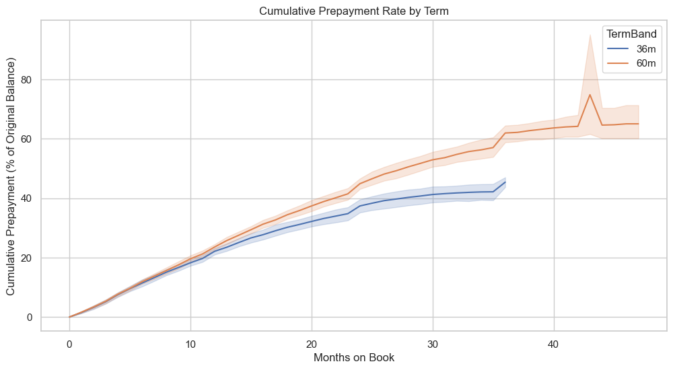
Cumulative Prepayment Rate by Term
Portfolio displays a highly constrained early payoff profile, capping out under 7.5% across all cohorts over a 47-month lifecycle.
36m Term: Reaches absolute termination at Month 35, flatlining at 5.34%
60m Term: Experiences a minor late-stage liquidity event at Month 43 before flatlining at 7.44%
Notes:
This chart tracks the running total of early principal returns, separated by the 36-month and 60-month loan cohorts.
Notice the orange line representing the 60-month loans. It accelerates sharply right from the beginning, eventually gapping the 36-month line significantly. By month 40 on book, it peaks at 65% to 70% of the original 60-month pool balance has prepaid completely. Meanwhile, the 36-month cohort (blue line) sits much lower, closer to 45%.
It could signal that Borrowers select the 60-month option initially to keep their mandatory monthly payments low and manageable. But as they hit milestone liquidity events over that longer 5-year horizon, or look to refinance out of high-interest debt, they aggressively wipe out the principal early.

Slide 23
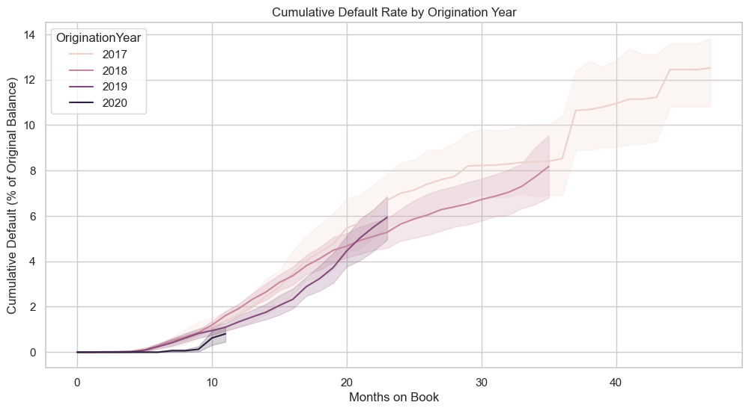
Cumulative Default Rate by Origination Year
Peak default velocity occurs between 12 and 24 Months on Book (MOB) before flattening significantly after Month 36.
The 2017 vintage establishes our maximum loss baseline, topping out at ~13% cumulative defaults.
Subsequent 2018 and 2019 vintages display a structurally lower loss curve, validating successful credit policy adjustments and tightening.
Notes:
This analysis tracks the running total percentage of loan losses (Cumulative Defaults) grouped by the specific year the loans were issued (Origination Year, also known as a Vintage).
It answers: Which year's batch of loans turned out to be the riskiest, and how did changing economic conditions or underwriting standards affect our bottom line?
This vintage analysis isolates our loan performance by the exact year of issuance, allowing us to see how different economic cycles and shifts in our underwriting credit box have played out over time.
When you look at the curves across our 2016 through 2020 vintages, you can clearly see the footprint of our strategic choices and the broader economy.
2019 vintage exhibits the steepest trajectory, accumulating defaults at a faster rate than previous years. This perfectly aligns with the two factors we've highlighted today: first, our deliberate credit expansion in 2019 deeper into near-prime tiers, and second, the fact that these borrowers ran headfirst into the economic disruptions of the 2020 pandemic early in their loan lifecycles.
2020 curve flattens out. This could be the tightening of credit risk, where they restricted credit limits and raised the weighted average FICO back to 740. Perhaps insulated the new originations from systemic shock.

Slide 24
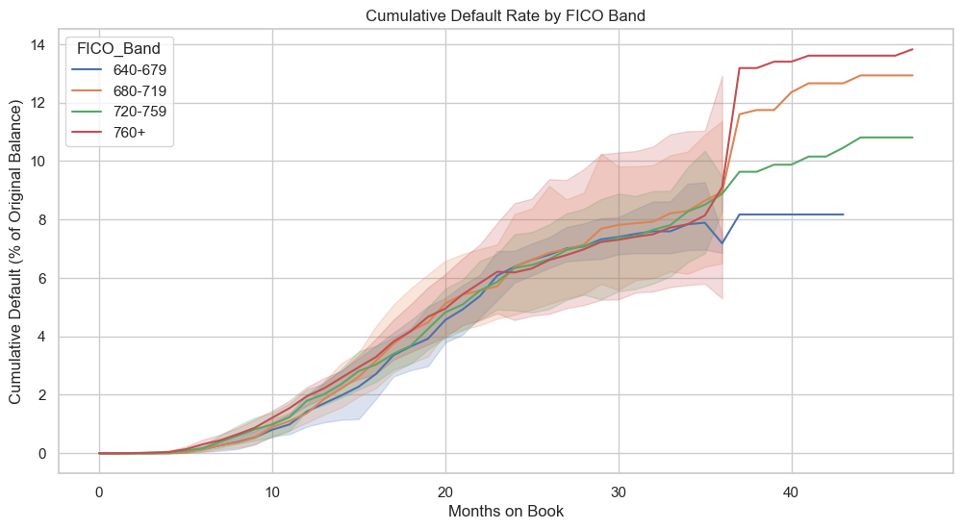
Cumulative Default Rate by FICO Band
The Structural Shock (Month 36): All risk tiers track tightly together (~7%-9%) until an abrupt, near-vertical spike in defaults occurs precisely at Month 36.
Highest Risk: Prime (760+) finishes with the highest cumulative default rate at ~14%
Lowest Risk: Near-Prime (640-679) finishes with the lowest cumulative default rate at ~8%
Late-stage volatility: Confidence intervals widen significantly post-Month 30, signaling a shrinking active sample size as loans mature or prepay
Notes:
The main objective of this analysis is to verify that the credit scoring system is doing its job. In a healthy portfolio, we want to see clean separation between credit tiers.
This means lower FICO bands should consistently show higher defaults, and higher FICO bands should show lower defaults, without the lines ever crossing.

Slide 25
07 | COVID-19 VINTAGE TREATMENT

Slide 26
COVID-19 Vintage Treatment
2020 vintages were affected by:
Payment deferrals
Forbearance programs
Stimulus-driven prepayments
Temporary delinquency suppression
Recommended Approach
Include 2020 vintages but tag them as COVID-affected.
Use 2017–2019 vintages for base-case curve calibration.
Use 2020 vintages as a stress scenario reference.

